Slide 1

RUNGTA COLLEGE OF DENTAL SCIENCES & RESEARCH
TITLE OF THE TOPIC:
Surgical and Non Surgical preparation of Edentulous patient
DEPARTMENT OF PROSTHODONTICS AND CROWN & BRIDGE

Slide 2
Specific learning Objectives
At the end of this presentation the learner is expected to know ;
Core areas* | Domain ** | Category #
Introduction | Cognitive | Must know
Definition | Cognitive | Must know
Types of surgeries | Cognitive | Must know
Management | Cognitive | Must know
Take home message | Cognitive | Must know
References | Affective | Desired to Know

Slide 3
Table of Content
Introduction
Definition
Types of surgeries
Management
Take home message
References

Slide 4
Preprosthetic surgery

Slide 5
Pre-prosthetic surgery encompass all surgical procedures relative to preparing the tissues to support the dentures, and in general contributing to the functional and esthetic success of the dentures.

Slide 6
Types of Surgery:
I. Basic preprosthetic surgical procedures
A. Removal of teeth - Erupted
- Unerupted
- Partially erupted
- Root stumps
- Cysts

Slide 7
Bony recontouring of alveolar ridges
Single alveoloplasty associated with removal of multiple teeth
Alveoloplasty
Maxillary tuberosity reduction
Buccal exostosis
Lateral palatal exostosis
Genial tubercle reduction

Slide 8
Tori Removal:
Maxillary tori
Mandibular tori
Soft tissues procedures:
Labial frenectomy
Lingual frenectomy
Inflammatory papillary hyperplasia of the palate
Unsupported hypermobile tissues
Epote fissuration

Slide 9
Advanced Pre-prosthetic surgery:
Surgery for ridge extension Vestibuloplasty
Surgery for ridge augmentation
Retained Dentition
Erupted
Unerupted
Partially erupted
Root stumps
Cysts.

Slide 10
Bony recontouring of alveolar ridges alveoloplasty:
It is the surgical contouring of the alveolar process. Conservative alveoloplasty is required after the extraction of the single tooth, if prominent areas of bone are left behind. Sharp bony spicuks may cause pressure zones under the Dentures.
Maxillary Tuberosity Reduction:
Lateral or vertical excess of the maxillary tuberosity area may be a result of excess bone, soft tissues or both.

Slide 11
Technique
Local anaesthesia
Crestal incision extending up to the posterior aspect of the tuberosity area
Full thickness mucoperiosteal flap is reflected in buccal and palatal directions
Bone is removed using a side cutting rongeur or rotary instrument.

Slide 12
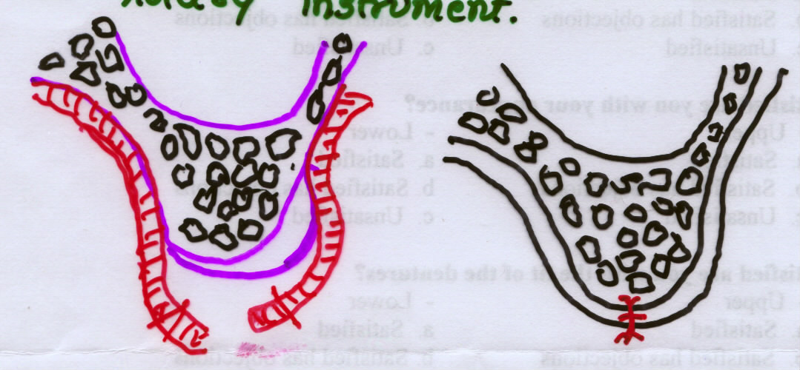
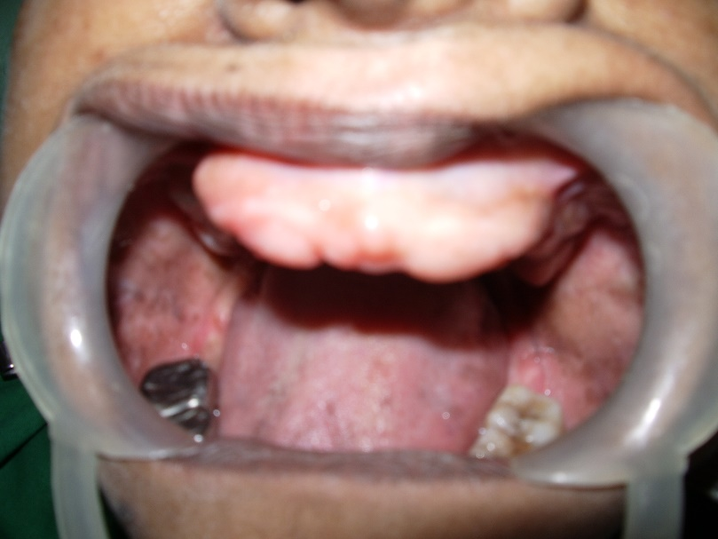
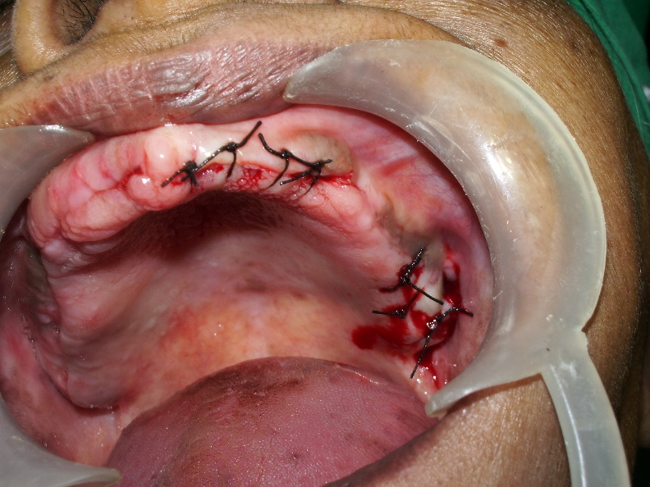
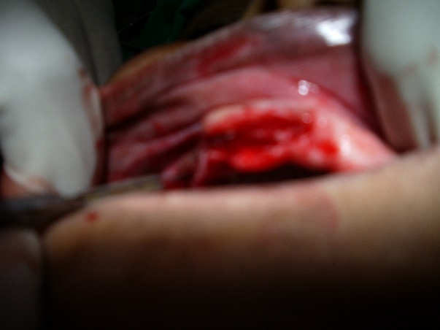

Slide 13
KNIFE EDGE RIDGE
Mid crestal incision
Flap is reflected
Rongeurs, bone files or rotary burs and employed for smoothening the alveolar process.
Wound is irrigated
Flap is replaced back
Sutured.

Slide 14
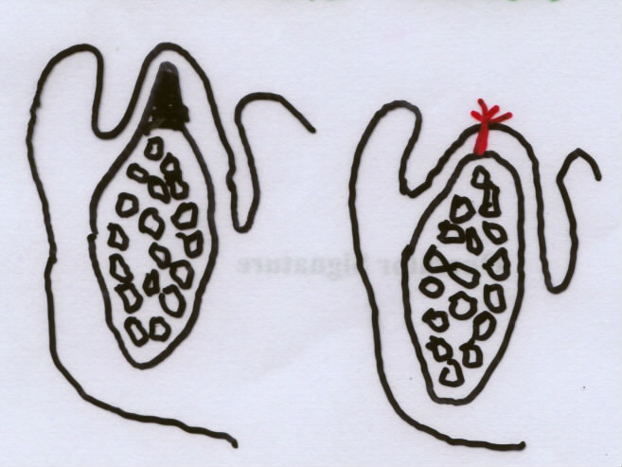

Slide 15
Tori are hard bony growth
Torus palatinus should be removed if one or more conditions exist
They are large and interfere with speech
Extend posteriorly affect PPSA
Denture stability, because of fulcrum
Small tori can be retained and the denture relieved to prevent the fulcrum effect.

Slide 16
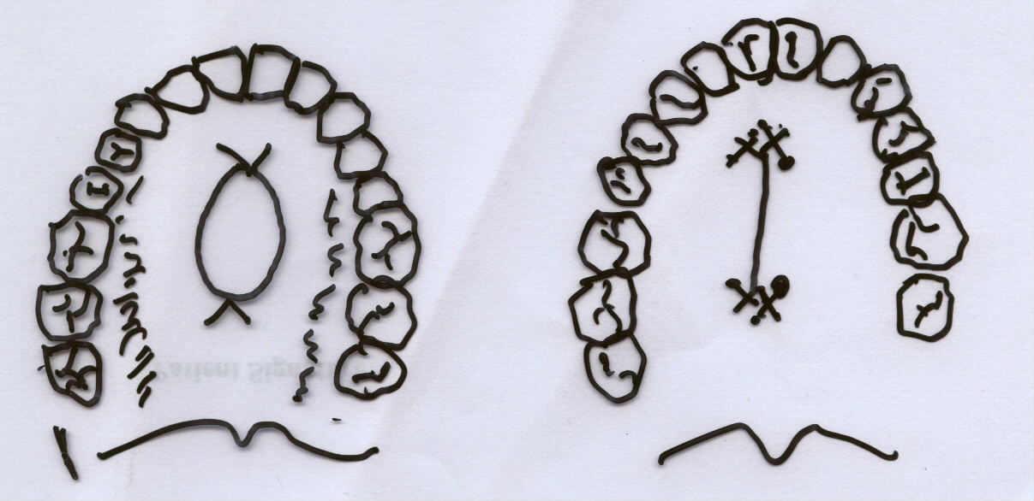

Slide 17
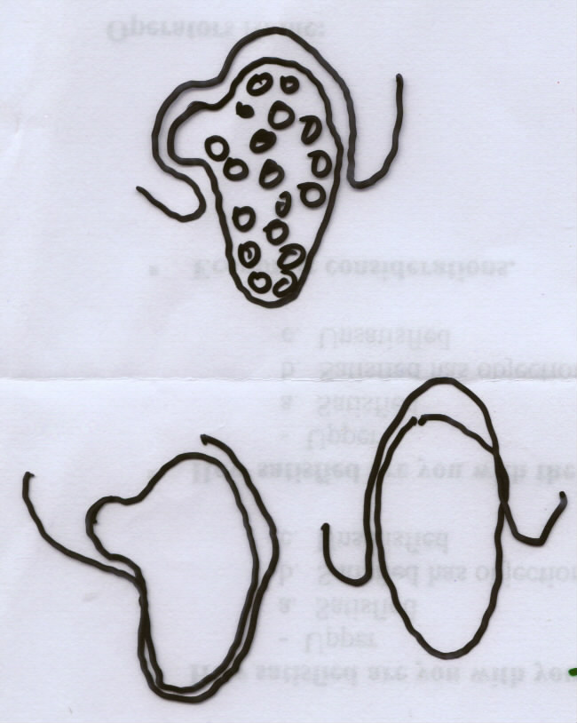

Slide 18
Soft Tissue Abnormalities
Prominent Labial Frenum:
A high frenal attachment of the labial frenum can cause instability of the denture and disturb the peripheral seal of the denture.
With No.11 B.P. blade, the labial frenum is excised by cutting around the outside surfaces of the two hemostats.

Slide 19
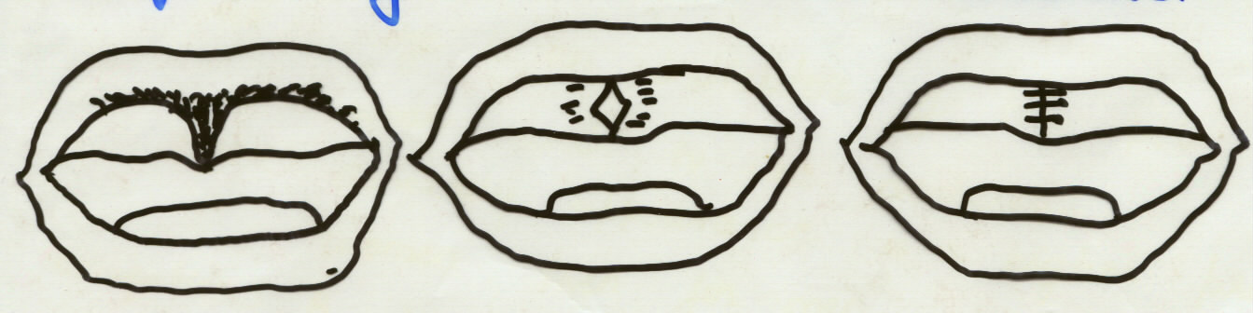
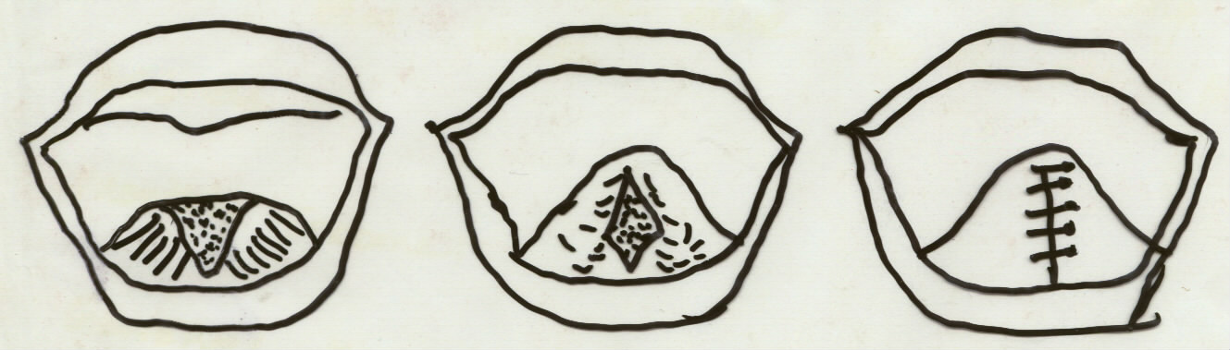
Lingual Frenectomy
Tongue is grasped with tongue holding forceps

Slide 20
Prominent Buccal Frenum!
Papillary Hyperplasia:
Develops in the palatal vault as multiple papillary projections of the epitheium in response to local irritation, poor oral hygiene, and low-grade infections such monilia

Slide 21
Epuli Fissuratum:
Result from chronic irritation of a poorly fitting denture flange on the sulcular epithelium. Lesion appears from small single folds to multiple folds or redundant soft tissue.
Rx: Tissue rest
Shortening of the flange
Surgical excision of fibrous tissue.

Slide 22
Ridge extension surgery: VESTIBULOPLASTY
Designed to restore alveolar ridge hight.
Indications: Good health
Maintenance
PE’s Co-operation
Contraindications:
Neurotic
Psychotic
Depressed
Medically compromised

Slide 23
Denture bearing area is increased by shifting the soft tissue attachments deeper. More commonly required in mandible than in maxilla
Labial Vestibuloplasty
Lingual vestibuloplasty
Incision: Depth of the sulcus disect supra periosteally to separate the labial and alveolar tissues.

Slide 24
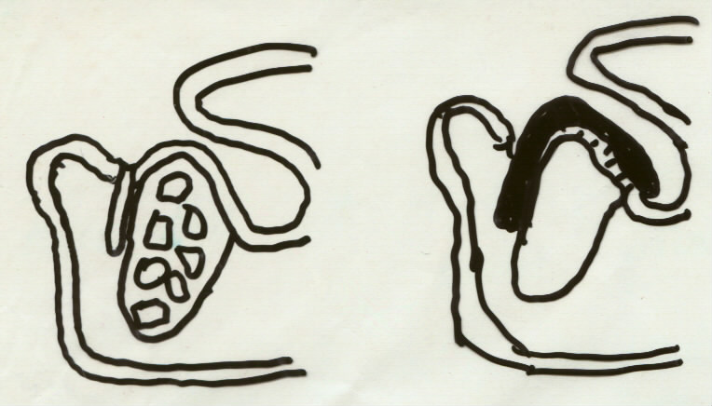
Raw area - Epithelization

Slide 25
Ridge Augmentation:
Involve replacement of bone autogenous bone from the 6th or 9th rib or iliac crest used in solid pieces than chips.
Alloplastic - HA crystals acrylic
Procedures involve:
Direct augmentation of the superior border mandible
Augmentation of the inf. Border of mandible
Augmentation of maxilla
Interposition bone grafts.

Slide 26
Summary
Many conditions exist in dentistry which may interfere during the construction of the dentures. Some of these conditions can be corrected by surgery which can improve patients function , comfort, aesthetics and psychology .

Slide 27
TAKE HOME MESSEGE
Knowledge of anomalies are essential ,
Selection of corrective procedure is utmost importance in preserving and maintain remaining structure after fabrication of the prosthesis

Slide 28
REFERENCES
Boucher’s Prosthodontic Treatment For Edentulous Patients, 12th Edition
Winkler’s Essentials Of Complete Denture Prosthdontics, 2nd Edition
Zarb & Bolender’s Prosthodontic Treatment For Edentulous Patients, 13th Edition
Rahn & Heartwell’s Textbook Of Complete Denture, 5th Edition.

Slide 29
THANK YOU

